Slide 1


Instagram User Analysis Project
The goal is to provide valuable insights to the product team at Instagram, which can then be used to make informed decisions about the future direction of the app. The tasks include identifying loyal users, inactive users, contest winners, popular hashtags, and optimal ad campaign launch days.

Slide 2

Approach
Data Collection
Trend Analysis
We collected data from a diverse range of Instagram users, ensuring a comprehensive representation.
Our approach involved analyzing trends and patterns in user interactions, content preferences, and engagement metrics.
To handle the tasks and derive insights, I began by setting up the provided database in MySQL Workbench. I then crafted SQL queries to extract the necessary information for each task. For tasks related to user engagement and behavior, I used aggregate functions and subqueries to calculate averages and identify patterns. Throughout the analysis, I ensured the accuracy and efficiency of the queries to obtain reliable results.

Slide 3

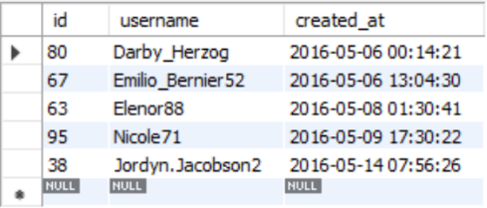
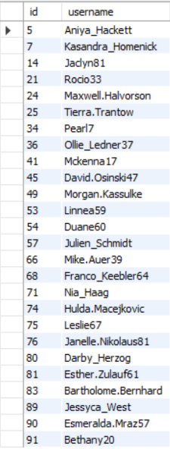
Marketing analysis by MySQL
1. Identify the five oldest users on Instagram from the provided database.
2. Identify users who have never posted a single photo on Instagram.
Select * from users order by created_at asc limit 5;
Select u.id, u.username from users u left join photos p on u.id=p.user_id where p.user_id is null ;
3. The winner of the contest and their details.
Select u.id,u.username,u.created_at,p.image_url,count(l.photo_id) as Total_likes from photos p join users u on p.user_id = u.id join likes l on l.user_id = u.id group by u.id,u.username,p.image_url
order by Total_likes desc limit 1;

Slide 4

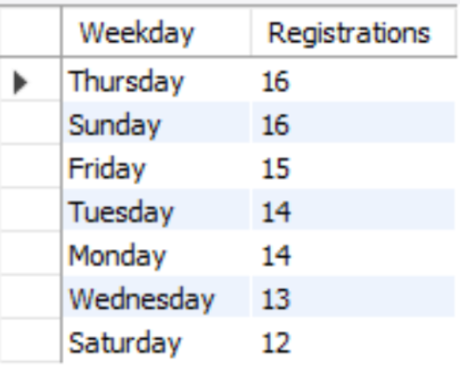
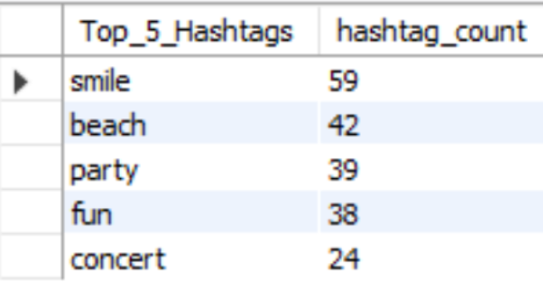
4.The top five most commonly used hashtags on the platform.
5.The day of the week when most users register on Instagram.
Select t.tag_name as Top_5_Hashtags, Count(t.tag_name) as hashtag_count from tags t join photo_tags pt on t.id = pt.tag_id join photos p on pt.photo_id = p.id group by t.tag_name
order by hashtag_count desc limit 5;
Select dayname(created_at)as Weekday, count(id) as Registrations from users group by dayname(created_at) order by Registrations desc;

Slide 5

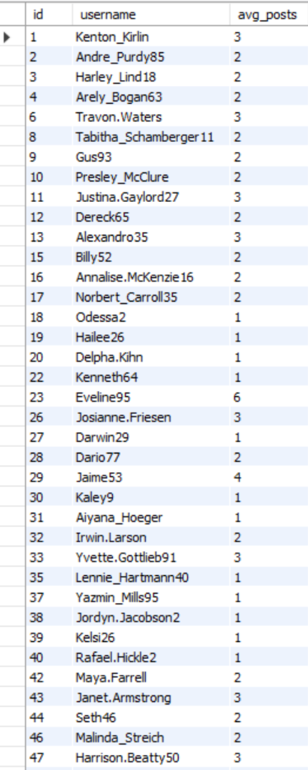
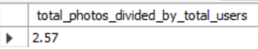
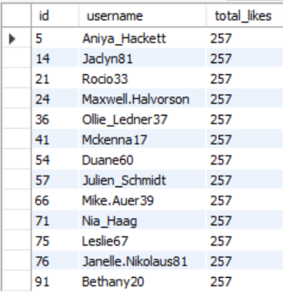
Investor Metrics by MySQL
6.The average number of posts per user on Instagram.
7.The total number of photos on Instagram divided by the total number of users.
Select u.id,u.username, round((count(p.image_url)/2)) as avg_posts from photos p join users u on p.user_id = u.id group by u.id,username;
Select
round((select count(image_url) from photos)/(select count(distinct(id)) from users),2) as total_photos_divided_by_total_users;
8.Identify users (potential bots) who have liked every single photo on the site, as this is not typically possible for a normal user.
To solve this first of all I have executed this query which gave me count of all photos.
Select count(*) from photos;
Then I have placed this query inside the main query using "having" function to get the results of users who liked all the posts.
Select u.id, username,count(u.id) as total_likes from users u join likes l on u.id = l.user_id group by u.id having total_likes = (select count(*) from photos);

Slide 6

Tech-stack Used
✅ MySQL Workbench
Version: MySQL Workbench 8.0.36
MySQL Workbench was chosen for its robust SQL querying capabilities and user-friendly interface. It allows for efficient manipulation and analysis of the provided database, making it an ideal tool for this project.
✅ Microsoft Power Point
Version: Microsoft Power Point
It is used to prepare the power point presentation.

Slide 7

Insights
Marketing Analysis:
The five oldest users on Instagram were identified based on their registration dates and the year of all registrations was 2016.
Users who have never posted a single photo are 26 who were identified for targeted promotional emails.
The winner of the contest with the most likes on a single photo was Annalise.McKenzie16 with total likes of 103.
The top five most commonly used hashtags on the platform which were suggested for partner's brand use are "smile", "beach", "party", "fun", "concert".
Insights on the best day of the week to launch ads were provided based on user registration patterns. According to this insight, it is discovered that most registrations occurred on Thursdays and Sundays.
Investor Metrics:
The average number of posts per user on Instagram was calculated where maximum is 6 and least is 1.
The total number of photos divided by the total number of users gives a value of 2.57.
Potential bot accounts were identified by 13 who have liked every single photo on the site.

Slide 8
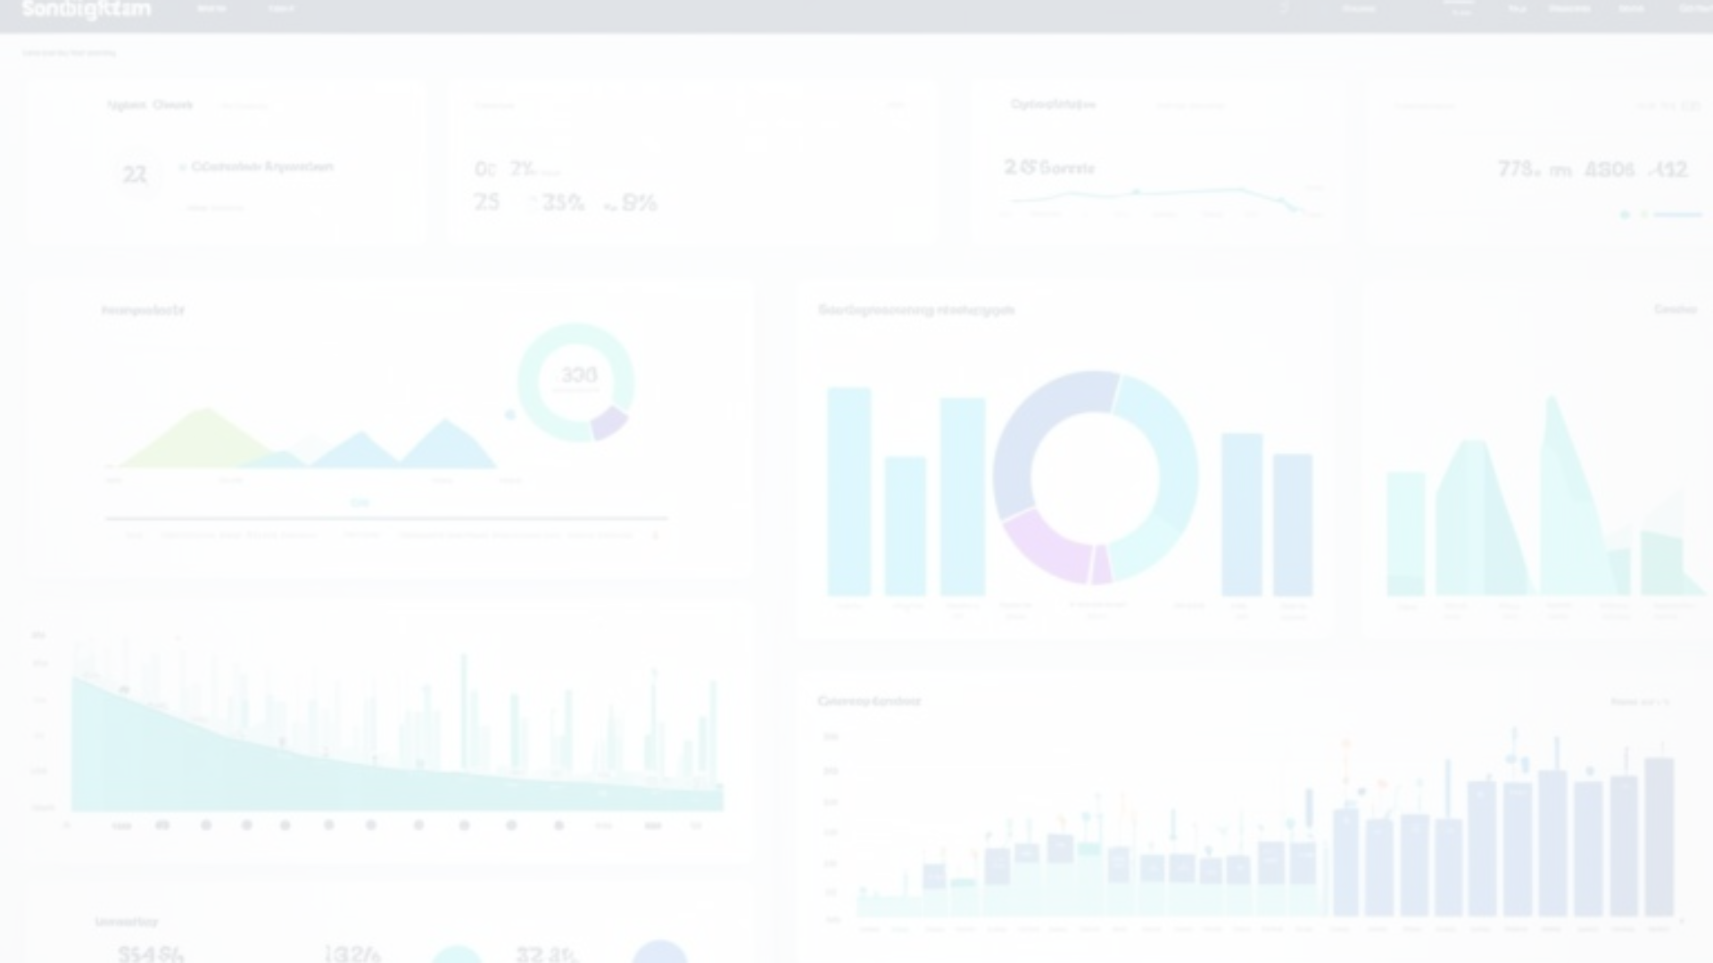
Result
Through this project, valuable insights were derived that can aid the product team in making data-driven decisions. The analysis provided information on user behavior, engagement, and trends, which can guide feature development, marketing strategies, and overall platform improvements. By leveraging SQL and MySQL Workbench, I'm able to efficiently extract meaningful insights from the Instagram user data.

Slide 9


Drive Link
For access to the comprehensive report and detailed findings,
please visit the following links:
Drive:
Github:

Slide 10

Thank you

